Slide 1
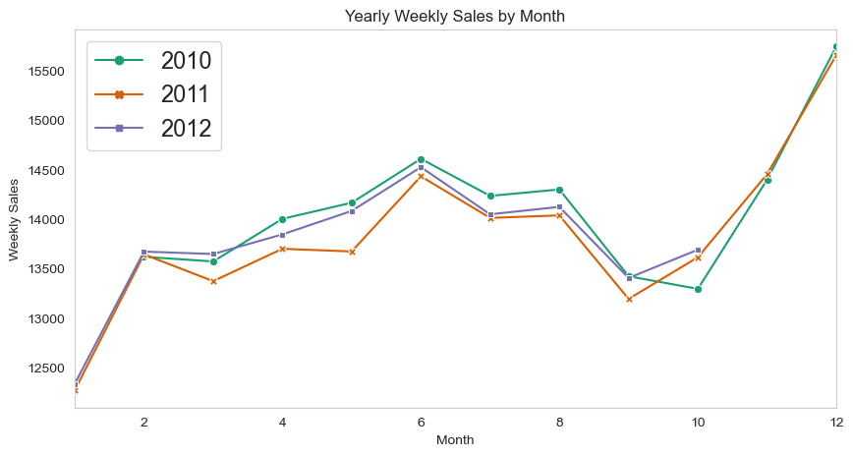
Walmart Sales Data Analysis:
Project Overview and Best Practices
Exploring sales trends, product performance, and customer behavior

Slide 2

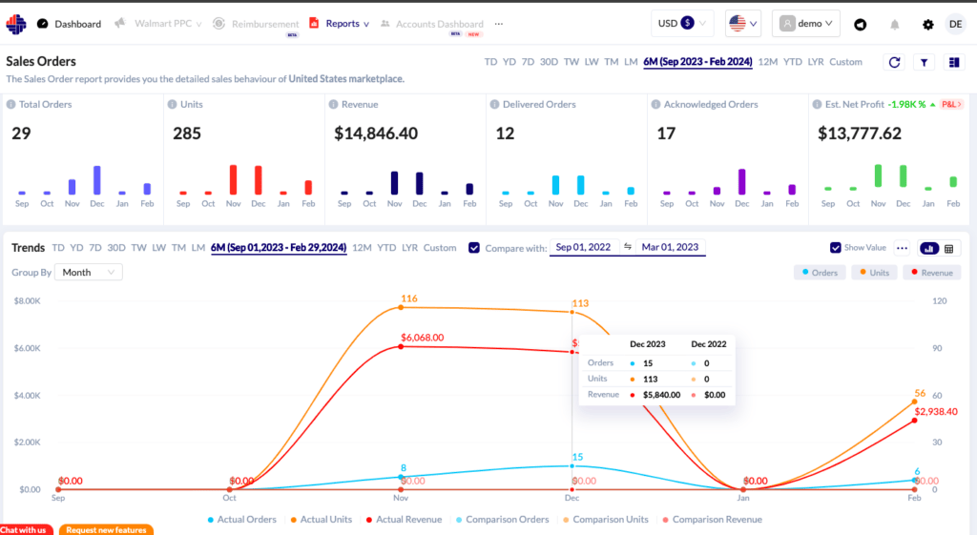






Project Overview
Dataset Source
Kaggle Walmart Sales Forecasting Competition
Dataset Structure
17 columns with sales transaction details
1000 rows of sales records
Key Features
Three Walmart branches in Myanmar
Locations: Mandalay, Yangon, Naypyitaw
Multiple product lines and customer segments

Slide 3









Project Objectives
Main Goal
Gain insights into Walmart sales data to understand factors affecting sales across different branches and optimize sales strategies
Product Analysis
Sales Analysis
Customer Analysis
Identify top-performing product lines
Evaluate sales trends by time/day/month
Identify customer segments
Analyze revenue by product category
Analyze purchase patterns
Determine product improvement areas
Measure effectiveness of sales strategies
Evaluate customer profitability
Identify peak sales periods
Expected Outcomes & Business Value
Data-driven decisions for inventory management and product assortment
Optimized sales strategies tailored to each branch's performance
Increased revenue through targeted marketing and promotions

Slide 4

















Analysis Approach
Data Wrangling
Feature Engineering
Exploratory Data Analysis
1
2
3
Data Wrangling
Feature Engineering
Exploratory Data Analysis
Build database using SQL
time_of_day column (Morning, Afternoon, Evening)
Product Analysis - top performers, revenue
Create tables with proper data types
day_name column (Mon, Tue, Wed, etc.)
Sales Analysis - trends, peak periods
Handle null values - none present in dataset
month_name column (Jan, Feb, Mar)
Customer Analysis - segments, behavior
Insert data into structured tables
product_category column (Good/Bad based on sales)
Revenue & Profit calculations and metrics

Slide 5





Key Business Questions
Generic Questions
Product Analysis
How many unique cities in the dataset?
How many unique product lines?
In which city is each branch located?
What is the most common payment method?
What is the most selling product line?
What is the total revenue by month?
Which product line had the largest revenue?
Sales Analysis
Customer Analysis
Number of sales made in each time of day per weekday
How many unique customer types?
Which customer type brings the most revenue?
What is the most common customer type?
Which city has the largest tax percent/VAT?
What is the gender distribution per branch?
Which customer type pays the most in VAT?
Which time of day do customers give most ratings?
Which day of the week has the best avg ratings?

Slide 6

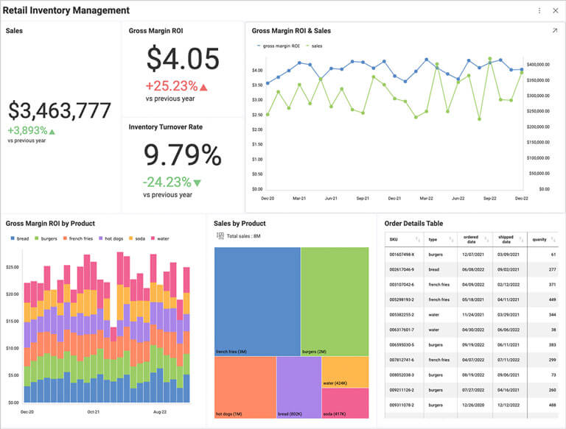



Retail Analytics Best Practices
Create Objectives and Goals
Set clear objectives before analyzing data. Focus on specific goals like increasing basket size, market share, or customer loyalty.
Use Historical Data
Examine both micro and macro trends in customer behavior across daily, weekly, monthly, and seasonal patterns.
Compare Metrics and Reports
Avoid analyzing data in silos. Compare velocity, incremental lift, and category level data to see the bigger picture.
Look for Trends
Use historical data to forecast demand, optimize inventory, and identify operational improvements across the supply chain.
Retail analytics dashboard showing key performance metrics
Use Offline and Online Data
Integrate data from multiple touchpoints to create a unified view of the customer journey and understand purchase motivations.

Slide 7





Implementation Recommendations
SQL Query Structure
Data Visualization
Use JOINs for related data
Bar charts for product comparisons
Apply GROUP BY with aggregate functions
Create CTEs for complex queries
Line charts for sales trends over time
Use window functions for rankings
Pie charts for category distributions
Heat maps for time-based patterns
SELECT product_line, SUM(total) AS revenue FROM sales GROUP BY product_line
Analysis Techniques
Reporting Format
Cohort analysis for customer segments
Executive summary with key findings
Time series for seasonal patterns
Correlation between variables
Branch-specific performance reports
ABC analysis for product categorization
Product line performance dashboards
Actionable recommendations based on insights

Slide 8





Expected Outcomes and Next Steps
Insights to Gain
Business Decisions
Next Steps
Top-performing branches and product lines
Inventory optimization for each branch
Implement SQL queries for analysis
Peak sales periods by time, day, and month
Targeted promotions for specific product lines
Create dashboards for visualization
Customer behavior patterns and preferences
Staff scheduling based on peak periods
Validate findings with stakeholders
Revenue drivers and profit margins
Marketing strategies for customer segments
Develop action plan based on insights
Conclusion
This Walmart sales data analysis project will provide actionable insights to optimize sales strategies, improve customer experience, and drive revenue growth across all three branches through data-driven decision making.

